Slide 1
The Project

Slide 2
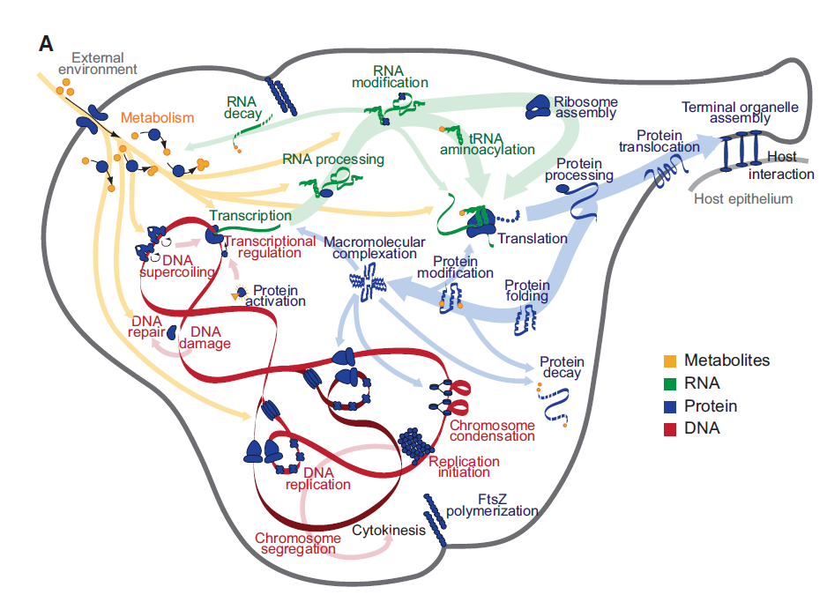
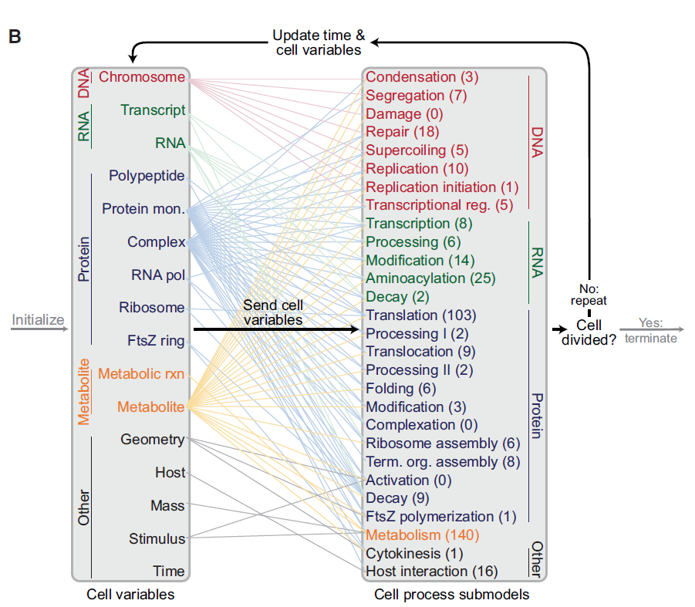
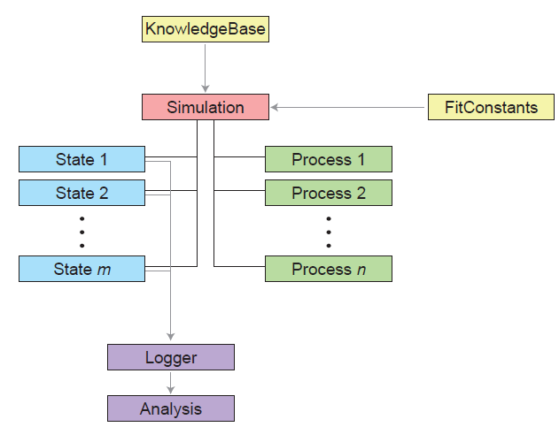
The Karr Model
Karr, Jonathan R., et al. "A whole-cell computational model predicts phenotype from genotype." Cell 150.2 (2012): 389-401.
Figure 1. M. genitalium Whole-Cell Model Integrates 28 Submodels of Diverse Cellular Processes
Schematic S17. Whole-cell model architecture.

Slide 3
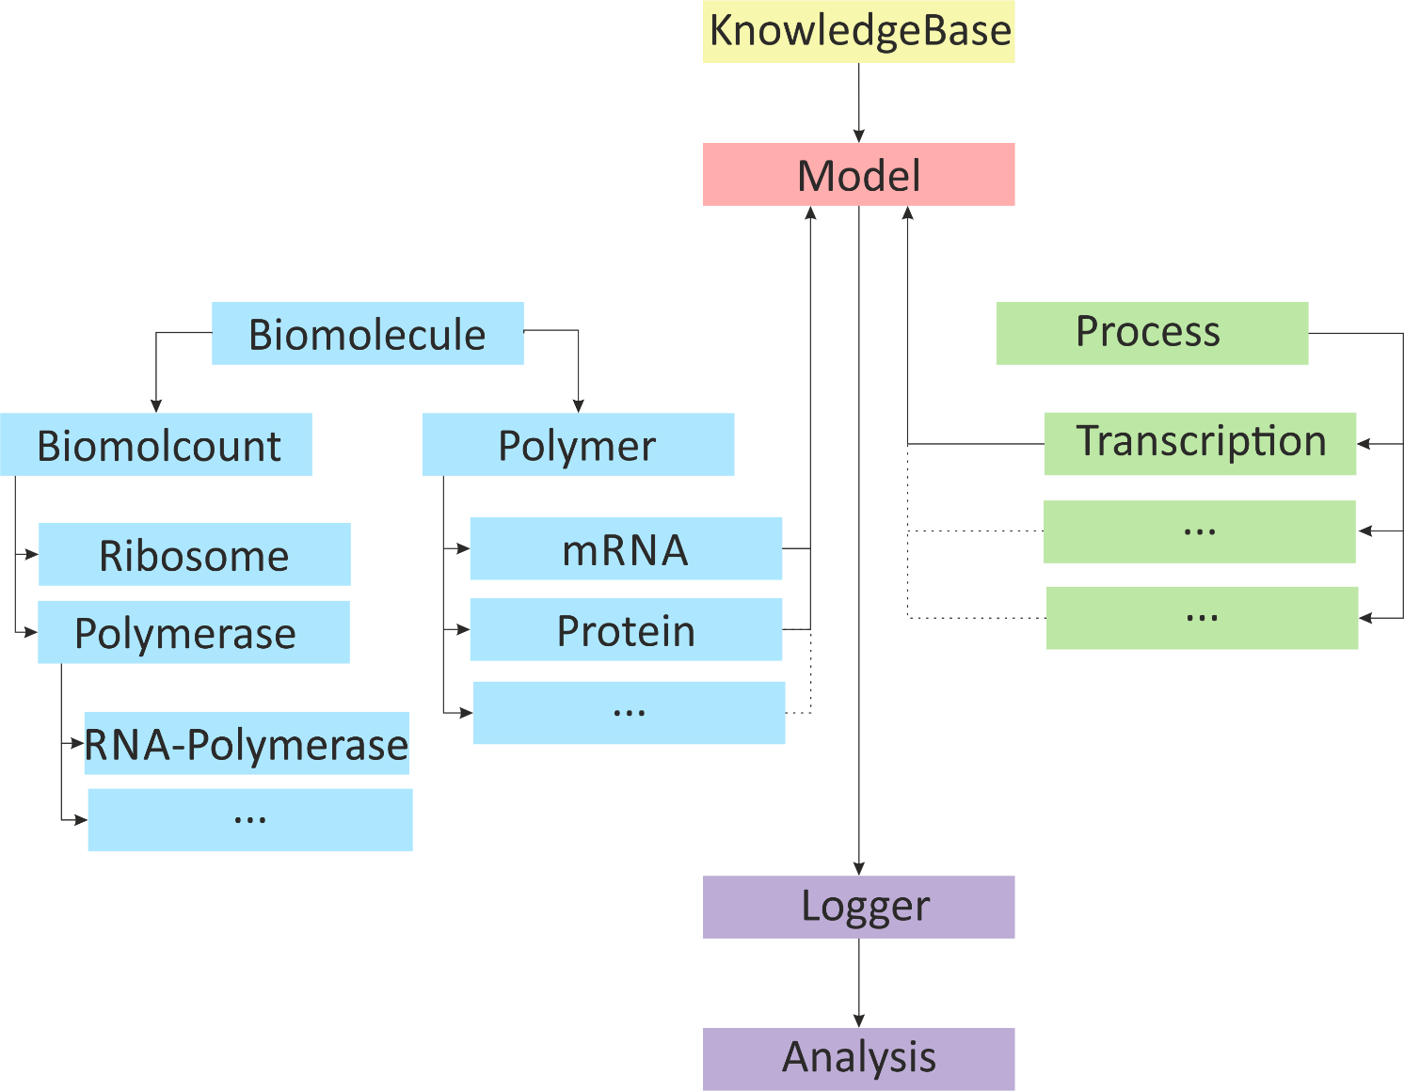
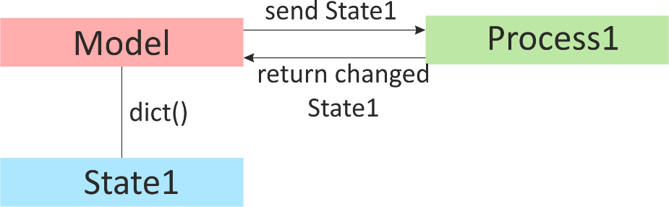
Our Model
General Classes
holding general information
Count Classes
Counting number of molecules
Property Classes
Holding specific property of e.g. state or process

Slide 4
Our Model - Task and Groups
Read, Understand
Write, Improve
Group
Input Generator/Knowledgebase
Transcription
Replication
Translation
Visualisation
Metabolite
Logger/Output Generator

Slide 5
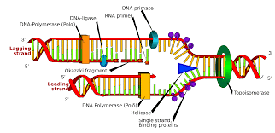
Replication
Minimal goal: Implement a replication class which is able to replicate a given genome
Functions: update, initiate, elongate, terminate
Additional goals:
How can you improve the implementation in an object oriented manner?
What kind of properties would be nice to have:
the length of the DNA, is a Helicase bound to the DNA, at which positions are the Helicase and/or Polymerase on the DNA and so on ….
Literature:
https://en.wikipedia.org/wiki/DNA_replication
http://biowiki.ucdavis.edu/Core/Genetics/ -> Unit II -> Replication in Yeast
http://dnareplication.cshl.edu/content/free/chapters/32_newlon.pdf

